Slide 2

Chapter Goals
To study several sorting and searching algorithms
To appreciate that algorithms for the same task can differ widely in performance
To understand the big-Oh notation
To estimate and compare the performance of algorithms
To write code to measure the running time of a program

Slide 3
Executing Time
Suppose two algorithms perform the same task such as search (linear search vs. binary search) and sorting (selection sort vs. insertion sort).
Which one is better? One possible approach to answer this question is to implement these algorithms in Java and run the programs to get execution time. But there are two problems for this approach:
First, there are many tasks running concurrently on a computer. The execution time of a particular program is dependent on the system load.
Second, the execution time is dependent on specific input. Consider linear search and binary search for example. If an element to be searched happens to be the first in the list, linear search will find the element quicker than binary search.

Slide 4
Growth Rate
It is very difficult to compare algorithms by measuring their execution time.
To overcome these problems, a theoretical approach was developed to analyze algorithms independent of computers and specific input.
This approach approximates the effect of a change on the size of the input.
In this way, you can see how fast an algorithm’s execution time increases as the input size increases, so you can compare two algorithms by examining their growth rates.

Slide 5
Big O Notation
Consider linear search. The linear search algorithm compares the key with the elements in the array sequentially until the key is found or the array is exhausted.
If the key is not in the array, it requires n comparisons for an array of size n. If the key is in the array, it requires n/2 comparisons on average.
The algorithm’s execution time is proportional to the size of the array.
If you double the size of the array, you will expect the number of comparisons to double.
The algorithm grows at a linear rate. The growth rate has an order of magnitude of n.
Computer scientists use the Big O notation to abbreviate for “order of magnitude.”
Using this notation, the complexity of the linear search algorithm is O(n), pronounced as “order of n.”

Slide 6
Best, Worst, and Average Cases
For the same input size, an algorithm’s execution time may vary, depending on the input.
An input that results in the shortest execution time is called the best-case input and an input that results in the longest execution time is called the worst-case input.
Best-case and worst-case are not representative, but worst-case analysis is very useful. You can show that the algorithm will never be slower than the worst-case.
An average-case analysis attempts to determine the average amount of time among all possible input of the same size.
Average-case analysis is ideal, but difficult to perform, because it is hard to determine the relative probabilities and distributions of various input instances for many problems.
Worst-case analysis is easier to obtain and is thus common. So, the analysis is generally conducted for the worst-case.

Slide 7
Ignoring Multiplicative Constants
The linear search algorithm requires n comparisons in the worst-case and n/2 comparisons in the average-case.
Using the Big O notation, both cases require O(n) time. The multiplicative constant (1/2) can be omitted.
Algorithm analysis is focused on growth rate.
The multiplicative constants have no impact on growth rates.
The growth rate for n/2 or 100n is the same as n, i.e., O(n) = O(n/2) = O(100n).

Slide 8
Ignoring Non-Dominating Terms
Consider the algorithm for finding the maximum number in an array of n elements.
If n is 2, it takes one comparison to find the maximum number.
If n is 3, it takes two comparisons to find the maximum number.
In general, it takes n-1 times of comparisons to find maximum number in a list of n elements.
Algorithm analysis is for large input size. If the input size is small, there is no significance to estimate an algorithm’s efficiency.
As n grows larger, the n part in the expression n-1 dominates the complexity.
The Big O notation allows you to ignore the non-dominating part (e.g., -1 in the expression n-1) and highlight the important part (e.g., n in the expression n-1). So, the complexity of this algorithm is O(n).

Slide 9
Examples: Determining Big-O
Repetition
Sequence
Selection
Logarithm

Slide 10
Useful Mathematic Summations

Slide 11
Repetition: Simple Loops
} executed n times
for (i = 1; i <= n; i++) {
k = k + 5;
}
constant time
Time Complexity
T(n) = (a constant c) * n = cn = O(n)
Ignore multiplicative constants (e.g., “c”).

Slide 12
Repetition: Nested Loops
executed
n times
for (i = 1; i <= n; i++) {
for (j = 1; j <= n; j++) {
k = k + i + j;
}
}
inner loop
executed
n times
constant time
Time Complexity
T(n) = (a constant c) * n * n = cn² = O(n²)
Ignore multiplicative constants (e.g., “c”).

Slide 13
Repetition: Nested Loops
executed
n times
for (i = 1; i <= n; i++) {
for (j = 1; j <= i; j++) {
k = k + i + j;
}
}
inner loop
executed
i times
constant time
Time Complexity
T(n) = c + 2c + 3c + 4c + … + nc = cn(n+1)/2 = (c/2)n² + (c/2)n = O(n²)
Ignore non-dominating terms
Ignore multiplicative constants

Slide 14
Repetition: Nested Loops
executed
n times
for (i = 1; i <= n; i++) {
for (j = 1; j <= 20; j++) {
k = k + i + j;
}
}
inner loop
executed
20 times
constant time
Time Complexity
T(n) = 20 * c * n = O(n)
Ignore multiplicative constants (e.g., 20*c)

Slide 15
Sequence
executed
n times
for (i = 1; i <= n; i++) {
for (j = 1; j <= 20; j++) {
k = k + i + j;
}
}
inner loop
executed
20 times
for (j = 1; j <= 10; j++) {
k = k + 4;
}
executed
10 times
Time Complexity
T(n) = c *10 + 20 * c * n = O(n)

Slide 16
Selection
O(n)
if (list.contains(e)) {
System.out.println(e);
}
else
for (Object t: list) {
System.out.println(t);
}
Let n be
list.size().
Executed
n times.
Time Complexity
T(n) = test time + worst-case (if, else)
= O(n) + O(n)
= O(n)

Slide 17
Constant Time
The Big O notation estimates the execution time of an algorithm in relation to the input size.
If the time is not related to the input size, the algorithm is said to take constant time with the notation O(1).
For example, a method that retrieves an element at a given index in an array takes constant time, because it does not grow as the size of the array increases.

Slide 18
Logarithmic Time
Ignoring constants and smaller terms, the complexity of the binary search algorithm is O(logn).
An algorithm with the O(logn) time complexity is called a logarithmic algorithm.
The base of the log is 2, but the base does not affect a logarithmic growth rate, so it can be omitted.
The logarithmic algorithm grows slowly as the problem size increases.
If you square the input size, you only double the time for the algorithm.

Slide 19
Quadratic Time
An algorithm with the O(n²) time complexity is called a quadratic algorithm.
The quadratic algorithm grows quickly as the problem size increases.
If you double the input size, the time for the algorithm is quadrupled.
Algorithms with a nested loop are often quadratic.

Slide 20

Selection Sort
In selection sort, pick the smallest element and swap it with the first one. Pick the smallest element of the remaining ones and swap it with the next one, and so on.

Slide 21

Selection Sort
A sorting algorithm rearranges the elements of a collection so that they are stored in sorted order.
Selection sort sorts an array by repeatedly finding the smallest element of the unsorted tail region and moving it to the front.
Slow when run on large data sets.
Example: sorting an array of integers

Slide 22





Sorting an Array of Integers
Find the smallest and swap it with the first element
Find the next smallest. It is already in the correct place
Find the next smallest and swap it with first element of unsorted portion
Repeat
When the unsorted portion is of length 1, we are done

Slide 23
section_1/SelectionSorter.java
1 /**
2 The sort method of this class sorts an array, using the selection
3 sort algorithm.
4 */
5 public class SelectionSorter
6 {
7 /**
8 Sorts an array, using selection sort.
9 @param a the array to sort
10 */
11 public static void sort(int[] a)
12 {
13 for (int i = 0; i < a.length - 1; i++)
14 {
15 int minPos = minimumPosition(a, i);
16 ArrayUtil.swap(a, minPos, i);
17 }
18 }
19
Continued

Slide 24
section_1/SelectionSorter.java
20 /**
21 Finds the smallest element in a tail range of the array.
22 @param a the array to sort
23 @param from the first position in a to compare
24 @return the position of the smallest element in the
25 range a[from] . . . a[a.length - 1]
26 */
27 private static int minimumPosition(int[] a, int from)
28 {
29 int minPos = from;
30 for (int i = from + 1; i < a.length; i++)
31 {
32 if (a[i] < a[minPos]) { minPos = i; }
33 }
34 return minPos;
35 }
36 }

Slide 25
section_1/SelectionSortDemo.java
1 import java.util.Arrays;
2
3 /**
4 This program demonstrates the selection sort algorithm by
5 sorting an array that is filled with random numbers.
6 */
7 public class SelectionSortDemo
8 {
9 public static void main(String[] args)
10 {
11 int[] a = ArrayUtil.randomIntArray(20, 100);
12 System.out.println(Arrays.toString(a));
13
14 SelectionSorter.sort(a);
15
16 System.out.println(Arrays.toString(a));
17 }
18 }
19
20
Typical Program Run:
[65, 46, 14, 52, 38, 2, 96, 39, 14, 33, 13, 4, 24, 99, 89, 77, 73, 87, 36, 81]
[2, 4, 13, 14, 14, 24, 33, 36, 38, 39, 46, 52, 65, 73, 77, 81, 87, 89, 96, 99]

Slide 26
Profiling the Selection Sort Algorithm
We want to measure the time the algorithm takes to execute:
Exclude the time the program takes to load
Exclude output time
To measure the running time of a method, get the current time immediately before and after the method call.
We will create a StopWatch class to measure execution time of an algorithm:
It can start, stop and give elapsed time
Use System.currentTimeMillis method
Create a StopWatch object:
Start the stopwatch just before the sort
Stop the stopwatch just after the sort
Read the elapsed time

Slide 27
section_2/StopWatch.java
1 /**
2 A stopwatch accumulates time when it is running. You can
3 repeatedly start and stop the stopwatch. You can use a
4 stopwatch to measure the running time of a program.
5 */
6 public class StopWatch
7 {
8 private long elapsedTime;
9 private long startTime;
10 private boolean isRunning;
11
12 /**
13 Constructs a stopwatch that is in the stopped state
14 and has no time accumulated.
15 */
16 public StopWatch()
17 {
18 reset();
19 }
20
Continued

Slide 28
section_2/StopWatch.java
21 /**
22 Starts the stopwatch. Time starts accumulating now.
23 */
24 public void start()
25 {
26 if (isRunning) { return; }
27 isRunning = true;
28 startTime = System.currentTimeMillis();
29 }
30
31 /**
32 Stops the stopwatch. Time stops accumulating and is
33 is added to the elapsed time.
34 */
35 public void stop()
36 {
37 if (!isRunning) { return; }
38 isRunning = false;
39 long endTime = System.currentTimeMillis();
40 elapsedTime = elapsedTime + endTime - startTime;
41 }
42
Continued

Slide 29
section_2/StopWatch.java
43 /**
44 Returns the total elapsed time.
45 @return the total elapsed time
46 */
47 public long getElapsedTime()
48 {
49 if (isRunning)
50 {
51 long endTime = System.currentTimeMillis();
52 return elapsedTime + endTime - startTime;
53 }
54 else
55 {
56 return elapsedTime;
57 }
58 }
59
60 /**
61 Stops the watch and resets the elapsed time to 0.
62 */
63 public void reset()
64 {
65 elapsedTime = 0;
66 isRunning = false;
67 }
68 }

Slide 30
section_2/SelectionSortTimer.java
1 import java.util.Scanner;
2
3 /**
4 This program measures how long it takes to sort an
5 array of a user-specified size with the selection
6 sort algorithm.
7 */
8 public class SelectionSortTimer
9 {
10 public static void main(String[] args)
11 {
12 Scanner in = new Scanner(System.in);
13 System.out.print("Enter array size: ");
14 int n = in.nextInt();
15
16 // Construct random array
17
18 int[] a = ArrayUtil.randomIntArray(n, 100);
19
Continued

Slide 31
section_2/SelectionSortTimer.java
20 // Use stopwatch to time selection sort
21
22 StopWatch timer = new StopWatch();
23
24 timer.start();
25 SelectionSorter.sort(a);
26 timer.stop();
27
28 System.out.println("Elapsed time: "
29 + timer.getElapsedTime() + " milliseconds");
30 }
31 }
32
33
Program Run:
Enter array size: 50000
Elapsed time: 13321 milliseconds

Slide 32
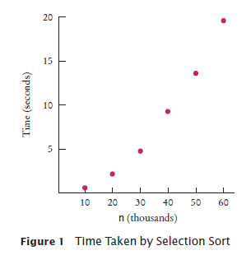
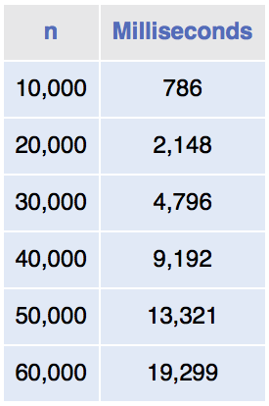
Selection Sort on Various Size Arrays
Doubling the size of the array more than doubles the time needed to sort it.

Slide 33
Analyzing the Performance of the Selection Sort Algorithm
In an array of size n, count how many times an array element is visited:
To find the smallest, visit n elements + 2 visits for the swap
To find the next smallest, visit (n - 1) elements + 2 visits for the swap
The last term is 2 elements visited to find the smallest + 2 visits for the swap

Slide 34
Analyzing the Performance of the Selection Sort Algorithm
The number of visits:
n + 2 + (n - 1) + 2 + (n - 2) + 2 + . . .+ 2 + 2
This can be simplified to n² /2 + 5n/2 - 3
5n/2 - 3 is small compared to n² /2 – so let's ignore it
Also ignore the 1/2 – it cancels out when comparing ratios

Slide 35
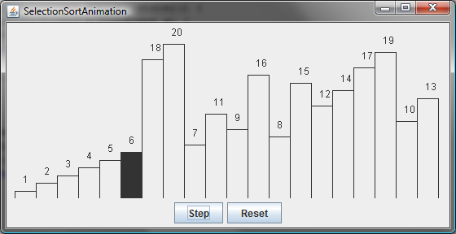
Selection Sort Animation
http://www.cs.armstrong.edu/liang/animation/web/SelectionSort.html
animation

Slide 36
Analyzing Selection Sort
The selection sort finds the smallest number in the list and places it last. It then finds the smallest number remaining and places it next to last, and so on until the list contains only a single number. The number of comparisons is n-1 for the first iteration, n-2 for the second iteration, and so on. Let T(n) denote the complexity for selection sort and c denote the total number of other operations such as assignments and additional comparisons in each iteration. So,
Ignoring constants and smaller terms, the complexity of the selection sort algorithm is O(n²).

Slide 37
Analyzing the Performance of the Selection Sort Algorithm
The number of visits is of the order n² .
Computer scientists use the big-Oh notation to describe the growth rate of a function.
Using big-Oh notation: The number of visits is O(n²).
Multiplying the number of elements in an array by 2 multiplies the processing time by 4.
To convert to big-Oh notation: locate fastest-growing term, and ignore constant coefficient.

Slide 38
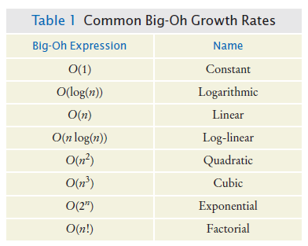
Common Big-Oh Growth Rates

Slide 39
Comparing Common Growth Functions
Constant time
Logarithmic time
Linear time
Log-linear time
Quadratic time
Cubic time
Exponential time

Slide 40
Comparing Common Growth Functions

Slide 41

Insertion Sort
Insertion sort is the method that many people use to sort playing cards. Pick up one card at a time and insert it so that the cards stay sorted.
Insertion sort is an O(n²) algorithm.

Slide 42
Insertion Sort
Insertion Sort is an algorithm used to sort a given list of items.
It does so by iterating through the list and building the sorted output one item at a time.
Upon each iteration, an item is taken from the list and inserted into the correct position by comparison with its neighbors.
This process is repeated until we reach the last item and there are no more left to be sorted.

Slide 43
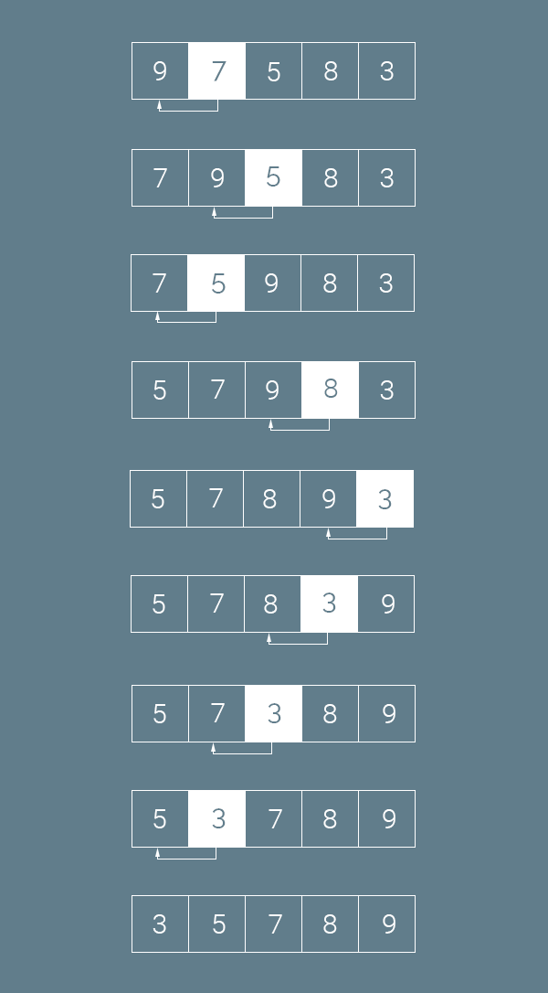
Insertion Sort

Slide 44





Insertion Sort
Assume initial sequence a[0] . . . a[k] is sorted (k = 0):
Add a[1]; element needs to be inserted before 11
Add a[2]
Add a[3]
Finally, add a[4]

Slide 45
Insertion Sort
public class InsertionSorter
{
/**
Sorts an array, using insertion sort.
@param a the array to sort
*/
public static void sort(int[] a)
{
for (int i = 1; i < a.length; i++)
{
int next = a[i];
// Move all larger elements up
int j = i;
while (j > 0 && a[j - 1] > next)
{
a[j] = a[j - 1];
j--;
}
// Insert the element
a[j] = next;
}
}
}

Slide 46
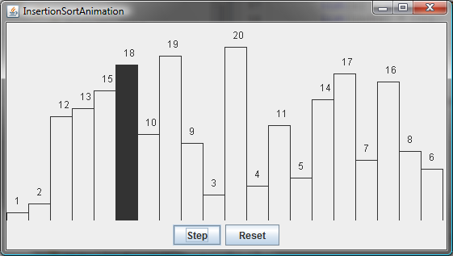
Insertion Sort Animation
http://www.cs.armstrong.edu/liang/animation/web/InsertionSort.html
animation

Slide 47
Analyzing Insertion Sort
The insertion sort algorithm sorts a list of values by repeatedly inserting a new element into a sorted partial array until the whole array is sorted. At the kth iteration, to insert an element to a array of size k, it may take k comparisons to find the insertion position, and k moves to insert the element. Let T(n) denote the complexity for insertion sort and c denote the total number of other operations such as assignments and additional comparisons in each iteration. So,
Ignoring constants and smaller terms, the complexity of the insertion sort algorithm is O(n²).

Slide 48
Insertion Sort – Advantages/Disadvantages
Let’s begin by taking a look at some of it’s advantages:
It’s a simple algorithm to implement
Performance is very high when operating with small lists
Even more so when the list is already mostly sorted, as fewer iterations of the sorting logic need to take place
However, the algorithm does hold some disadvantages:
Performance suffers when large lists are used, as this could involve carrying out a lot of comparisons and shifting of array items
The algorithm doesn’t perform as well as the merge sort and quick sort algorithms.

Slide 49

Merge Sort
Sorts an array by
Cutting the array in half
Recursively sorting each half
Merging the sorted halves
Dramatically faster than the selection sort In merge sort, one sorts each half, then merges the sorted halves.

Slide 50
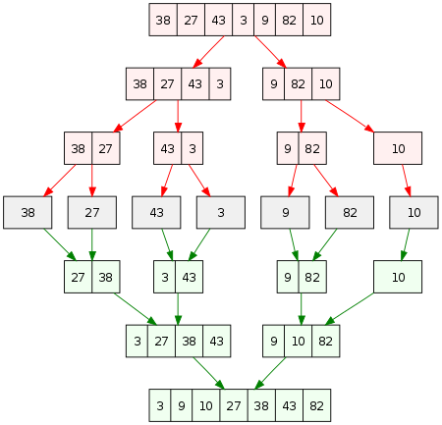
Merge Sort Example

Slide 51
Merge Sort
public static void sort(int[] a)
{
if (a.length <= 1) { return; }
int[] first = new int[a.length / 2];
int[] second = new int[a.length - first.length];
// Copy the first half of a into first, the second half into second
. . .
sort(first);
sort(second);
merge(first, second, a);
}

Slide 52
section_4/MergeSorter.java
1 /**
2 The sort method of this class sorts an array, using the merge
3 sort algorithm.
4 */
5 public class MergeSorter
6 {
7 /**
8 Sorts an array, using merge sort.
9 @param a the array to sort
10 */
11 public static void sort(int[] a)
12 {
13 if (a.length <= 1) { return; }
14 int[] first = new int[a.length / 2];
15 int[] second = new int[a.length - first.length];
16 // Copy the first half of a into first, the second half into second
17 for (int i = 0; i < first.length; i++)
18 {
19 first[i] = a[i];
20 }
21 for (int i = 0; i < second.length; i++)
22 {
23 second[i] = a[first.length + i];
24 }
25 sort(first);
26 sort(second);
27 merge(first, second, a);
28 }
29
Continued

Slide 53
section_4/MergeSorter.java
30 /**
31 Merges two sorted arrays into an array
32 @param first the first sorted array
33 @param second the second sorted array
34 @param a the array into which to merge first and second
35 */
36 private static void merge(int[] first, int[] second, int[] a)
37 {
38 int iFirst = 0; // Next element to consider in the first array
39 int iSecond = 0; // Next element to consider in the second array
40 int j = 0; // Next open position in a
41
42 // As long as neither iFirst nor iSecond is past the end, move
43 // the smaller element into a
44 while (iFirst < first.length && iSecond < second.length)
45 {
46 if (first[iFirst] < second[iSecond])
47 {
48 a[j] = first[iFirst];
49 iFirst++;
50 }
51 else
52 {
53 a[j] = second[iSecond];
54 iSecond++;
55 }
56 j++;
57 }
58
Continued

Slide 54
section_4/MergeSorter.java
59 // Note that only one of the two loops below copies entries
60 // Copy any remaining entries of the first array
61 while (iFirst < first.length)
62 {
63 a[j] = first[iFirst];
64 iFirst++; j++;
65 }
66 // Copy any remaining entries of the second half
67 while (iSecond < second.length)
68 {
69 a[j] = second[iSecond];
70 iSecond++; j++;
71 }
72 }
73 }

Slide 55
section_4/MergeSortDemo.java
1 import java.util.Arrays;
2
3 /**
4 This program demonstrates the merge sort algorithm by
5 sorting an array that is filled with random numbers.
6 */
7 public class MergeSortDemo
8 {
9 public static void main(String[] args)
10 {
11 int[] a = ArrayUtil.randomIntArray(20, 100);
12 System.out.println(Arrays.toString(a));
13
14 MergeSorter.sort(a);
15
16 System.out.println(Arrays.toString(a));
17 }
18 }
19
Typical Program Run:
[8, 81, 48, 53, 46, 70, 98, 42, 27, 76, 33, 24, 2, 76, 62, 89, 90, 5, 13, 21]
[2, 5, 8, 13, 21, 24, 27, 33, 42, 46, 48, 53, 62, 70, 76, 76, 81, 89, 90, 98]

Slide 56
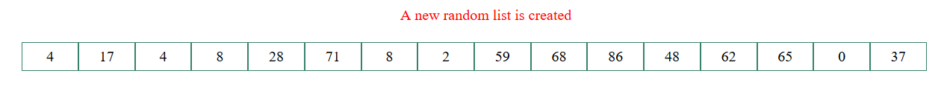
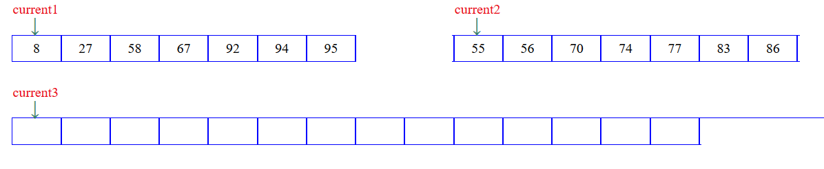
Merge Sort
https://yongdanielliang.github.io/animation/web/MergeSortOverview.html
https://yongdanielliang.github.io/animation/web/MergeSortNew.html

Slide 57
Analyzing the Merge Sort Algorithm
A divide-and-conquer solution for sorting an array gives an algorithm known as mergesort:
Mergesort:
Divide: Divide an array of n elements into two arrays of
n/2 elements each.
Conquer: Sort the two arrays recursively.
Combine: Merge the two sorted arrays.

Slide 58
Analyzing the Merge Sort Algorithm
On a "traditional" merge sort, each pass through the data doubles the size of the sorted subsections. After the first pass, the file will be sorted into sections of length two. After the second pass, length four. Then eight, sixteen, etc. up to the size of the file.
It's necessary to keep doubling the size of the sorted sections until there's one section comprising the whole file. It will take log(n) doublings of the section size to reach the file size, and each pass of the data will take time proportional to the number of records.
Using big-Oh notation: number of visits is O(n log(n)).

Slide 59
Merge Sort Vs Selection Sort
Selection sort is an O(n²) algorithm.
Merge sort is an O(n log(n)) algorithm.
The n log(n) function grows much more slowly than n².

Slide 60
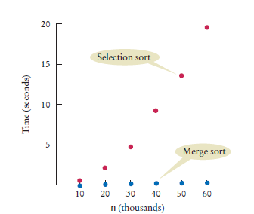
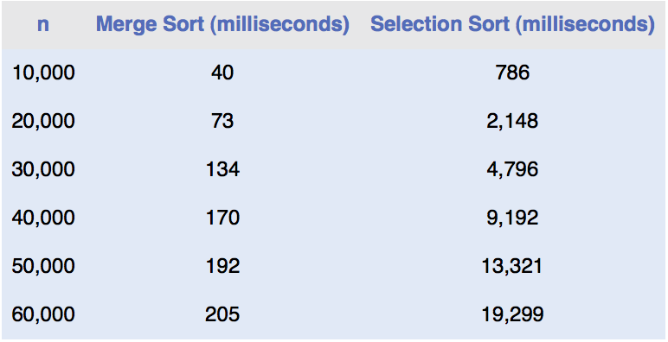
Merge Sort Timing vs. Selection Sort

Slide 61
The Quicksort Algorithm
Quicksort is a divide and conquer algorithm. Quicksort first divides a large array into two smaller sub-arrays: the low elements and the high elements. Quicksort can then recursively sort the sub-arrays.
The steps are:
Pick an element, called a pivot, from the array.
Partitioning: reorder the array so that all elements with values less than the pivot come before the pivot, while all elements with values greater than the pivot come after it (equal values can go either way). After this partitioning, the pivot is in its final position. This is called the partition operation.
Recursively apply the above steps to the sub-array of elements with smaller values and separately to the sub-array of elements with greater values.

Slide 62
The Quicksort Algorithm
The base case of the recursion is arrays of size zero or one, which are in order by definition, so they never need to be sorted.
The pivot selection and partitioning steps can be done in several different ways; the choice of specific implementation schemes greatly affects the algorithm's performance.
There are many different versions of quickSort that pick pivot in different ways.
Always pick first element as pivot.
Always pick last element as pivot (implemented below)
Pick a random element as pivot.
Pick median as pivot.

Slide 63
The Quicksort Algorithm
public void sort(int from, int to)
{
if (from >= to) return;
int p = partition(from, to);
sort(from, p);
sort(p + 1, to);
}

Slide 64



The Quicksort Algorithm
Starting range
A partition of the range so that no element in first section is larger than element in second section
Recursively apply the algorithm until array is sorted

Slide 65
The Quicksort Algorithm
private static int partition(int[] a, int from, int to)
{
int pivot = a[from];
int i = from - 1;
int j = to + 1;
while (i &lt; j)
{
i++; while (a[i] < pivot) { i++; }
j--; while (a[j] > pivot) { j--; }
if (i &lt; j) { ArrayUtil.swap(a, i, j); }
}
return j;
}

Slide 66
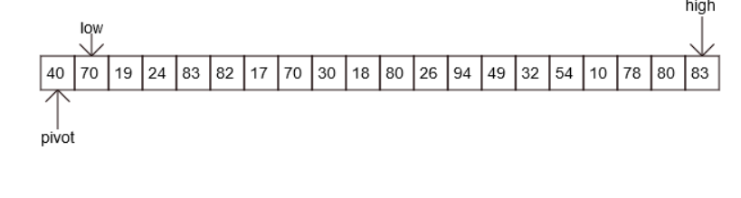
The Quicksort Algorithm - Partioning
http://www.cs.armstrong.edu/liang/animation/web/QuickSortPartition.html

Slide 67
The Quicksort Algorithm
On average, the quicksort algorithm is an O(n log(n)) algorithm.
Its worst-case run-time behavior is O(n²).

Slide 68
Analysis of Quicksort
The worst case occurs when the partition process always picks greatest or smallest element as pivot.
If we consider the partition strategy where last element is always picked as pivot, the worst case would occur when the array is already sorted in increasing or decreasing order.
The best case occurs when the partition process always picks the middle element as pivot.

Slide 69


Worst Case Analysis of Quicksort
The most unbalanced partition occurs when one of the sublists returned by the partitioning routine is of size n − 1. This may occur if the pivot happens to be the smallest or largest element in the list.
If this happens repeatedly in every partition, then each recursive call processes a list of size one less than the previous list. Consequently, we can make n − 1 nested calls before we reach a list of size 1. This means that the call tree is a linear chain of n − 1 nested calls. The ith call does O(n − i) work to do the partition

Slide 70
Best/Avg Case Analysis of Quicksort
In the most balanced case, each time we perform a partition we divide the list into two nearly equal pieces.
This means each recursive call processes a list of half the size. Consequently, we can make only log₂ n nested calls before we reach a list of size 1.
This means that the depth of the call tree is log₂ n.
But no two calls at the same level of the call tree process the same part of the original list; so, each level of calls needs only O(n) time all together
The result is that the algorithm uses only O(n log n) time.

Slide 71
Searching
Linear search: also called sequential search
Examines all values in an array until it finds a match or reaches the end
Number of visits for a linear search of an array of n elements:
The average search visits n/2 elements
The maximum visits is n
A linear search locates a value in an array in O(n) steps

Slide 72
section_6_1/LinearSearcher.java
1 /**
2 A class for executing linear searches in an array.
3 */
4 public class LinearSearcher
5 {
6 /**
7 Finds a value in an array, using the linear search
8 algorithm.
9 @param a the array to search
10 @param value the value to find
11 @return the index at which the value occurs, or -1
12 if it does not occur in the array
13 */
14 public static int search(int[] a, int value)
15 {
16 for (int i = 0; i < a.length; i++)
17 {
18 if (a[i] == value) { return i; }
19 }
20 return -1;
21 }
22 }

Slide 73
section_6_1/LinearSearchDemo.java
1 import java.util.Arrays;
2 import java.util.Scanner;
3
4 /**
5 This program demonstrates the linear search algorithm.
6 */
7 public class LinearSearchDemo
8 {
9 public static void main(String[] args)
10 {
11 int[] a = ArrayUtil.randomIntArray(20, 100);
12 System.out.println(Arrays.toString(a));
13 Scanner in = new Scanner(System.in);
14
15 boolean done = false;
16 while (!done)
17 {
18 System.out.print("Enter number to search for, -1 to quit: ");
19 int n = in.nextInt();
20 if (n == -1)
21 {
22 done = true;
23 }
24 else
25 {
26 int pos = LinearSearcher.search(a, n);
27 System.out.println("Found in position " + pos);
28 }
29 }
30 }
31 }
Continued

Slide 74
section_6_1/LinearSearchDemo.java
Program Run:
[46, 99, 45, 57, 64, 95, 81, 69, 11, 97, 6, 85, 61, 88, 29, 65, 83, 88, 45, 88]
Enter number to search for, -1 to quit: 12
Found in position -1
Enter number to search for, -1 to quit: -1

Slide 75
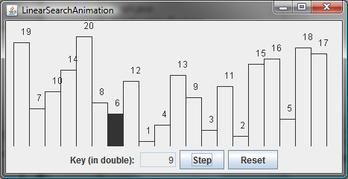
Linear Search Animation
http://www.cs.armstrong.edu/liang/animation/web/LinearSearch.html
animation

Slide 76
Binary Search
A binary search locates a value in a sorted array by:
Determining whether the value occurs in the first or second half
Then repeating the search in one of the halves
The size of the search is cut in half with each step.
Binary search compares the target value to the middle element of the array.
If they are not equal, the half in which the target cannot lie is eliminated and the search continues on the remaining half, again taking the middle element to compare to the target value, and repeating this until the target value is found.
If the search ends with the remaining half being empty, the target is not in the array.

Slide 77



Binary Search
Searching for 15 in this array
The last value in the first half is 9
So look in the second (darker colored) half
The last value of the first half of this sequence is 17
Look in the darker colored sequence

Slide 78

Binary Search
The last value of the first half of this very short sequence is 12,
This is smaller than the value that we are searching,
so we must look in the second half
15 ≠ 17: we don't have a match

Slide 79
section_6_2/BinarySearcher.java
1 /**
2 A class for executing binary searches in an array.
3 */
4 public class BinarySearcher
5 {
6 /**
7 Finds a value in a range of a sorted array, using the binary
8 search algorithm.
9 @param a the array in which to search
10 @param low the low index of the range
11 @param high the high index of the range
12 @param value the value to find
13 @return the index at which the value occurs, or -1
14 if it does not occur in the array
15 */
Continued

Slide 80
section_6_2/BinarySearcher.java
16 public static int search(int[] a, int low, int high, int value)
17 {
18 if (low <= high)
19 {
20 int mid = (low + high) / 2;
21
22 if (a[mid] == value)
23 {
24 return mid;
25 }
26 else if (a[mid] < value )
27 {
28 return search(a, mid + 1, high, value);
29 }
30 else
31 {
32 return search(a, low, mid - 1, value);
33 }
34 }
35 else
36 {
37 return -1;
38 }
39 }
40 }
41

Slide 81
Analyzing Binary Search
Let's see how to analyze the maximum number of guesses that binary search makes.
The key idea is that when binary search makes an incorrect guess, the portion of the array that contains reasonable guesses is reduced by at least half. If the reasonable portion had 32 elements, then an incorrect guess cuts it down to have at most 16. Binary search halves the size of the reasonable portion upon every incorrect guess.
If we start with an array of length 8, then incorrect guesses reduce the size of the reasonable portion to 4, then 2, and then 1. Once the reasonable portion contains just one element, no further guesses occur; the guess for the 1-element portion is either correct or incorrect, and we're done. So with an array of length 8, binary search needs at most four guesses.

Slide 82
Analyzing Binary Search
What do you think would happen with an array of 16 elements? If you said that the first guess would eliminate at least 8 elements, so that at most 8 remain, you're getting the picture. So with 16 elements, we need at most five guesses.
By now, you're probably seeing the pattern. Every time we double the size of the array, we need at most one more guess. Suppose we need at most m guesses for an array of length n. Then, for an array of length 2n, the first guess cuts the reasonable portion of the array down to size n and at most m m mm guesses finish up, giving us a total of at most m+1 guesses.

Slide 83
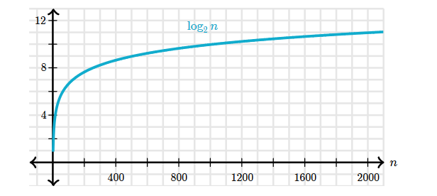
Analyzing Binary Search
Let's look at the general case of an array of length n.
We can express the number of guesses, in the worst case, as "the number of times we can repeatedly halve, starting at n until we get the value 1, plus one
So binary search is O(log(n) +1)=O(log(n))

Slide 84
Binary Search vs. Linear Search
Should we sort an array before searching?
Linear search - O(n)
Binary search - O(log(n))
If you search the array only once
Linear search is more efficient
If you will make many searches
Worthwhile to sort and use binary search

Slide 85
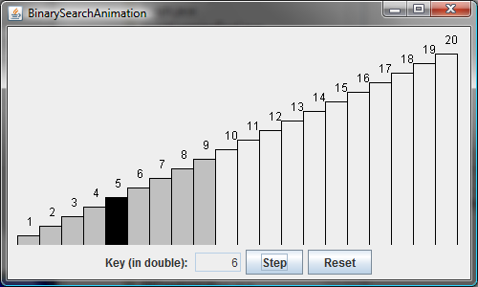
Binary Search Animation
http://www.cs.armstrong.edu/liang/animation/web/BinarySearch.html
animation

Slide 86
Analyzing Towers of Hanoi
TowersOfHanoi.java, moves n disks from tower A to tower B with the assistance of tower C recursively as follows:
Move the first n – 1 disks from A to C with the assistance of tower B.
Move disk n from A to B.
Move n - 1 disks from C to B with the assistance of tower A.
Let T(n) denote the complexity for the algorithm that moves disks and c denote the constant time to move one disk, i.e., T(1) is c. So,

Slide 87
Case Study: Fibonacci Numbers
/** The method for finding the Fibonacci number */
public static long fib(long index) {
if (index == 0) // Base case
return 0;
else if (index == 1) // Base case
return 1;
else // Reduction and recursive calls
return fib(index - 1) + fib(index - 2);
}
Finonacci series: 0 1 1 2 3 5 8 13 21 34 55 89…
indices: 0 1 2 3 4 5 6 7 8 9 10 11
fib(0) = 0;
fib(1) = 1;
fib(index) = fib(index -1) + fib(index -2); index >=2

Slide 88
Complexity for Recursive Fibonacci Numbers
Since
and
Therefore, the recursive Fibonacci method takes

Slide 89
Case Study: Non-recursive version of Fibonacci Numbers
public static long fib(long n) {
long f0 = 0; // For fib(0)
long f1 = 1; // For fib(1)
long f2 = 1; // For fib(2)
if (n == 0)
return f0;
else if (n == 1)
return f1;
else if (n == 2)
return f2;
for (int i = 3; i <= n; i++) {
f0 = f1;
f1 = f2;
f2 = f0 + f1;
}
return f2;
}
Obviously, the complexity of this new algorithm is
This is a tremendous improvement over the recursive algorithm.

Slide 90
f0 f1 f2
Fibonacci series: 0 1 1 2 3 5 8 13 21 34 55 89…
indices: 0 1 2 3 4 5 6 7 8 9 10 11
f0 f1 f2
Fibonacci series: 0 1 1 2 3 5 8 13 21 34 55 89…
indices: 0 1 2 3 4 5 6 7 8 9 10 11
f0 f1 f2
Fibonacci series: 0 1 1 2 3 5 8 13 21 34 55 89…
indices: 0 1 2 3 4 5 6 7 8 9 10 11
f0 f1 f2
Fibonacci series: 0 1 1 2 3 5 8 13 21 34 55 89…
indices: 0 1 2 3 4 5 6 7 8 9 10 11

Slide 91
Problem Solving: Estimating the Running Time of an Algorithm - Linear time
Example: an algorithm that counts how many elements have a particular value
int count = 0;
for (int i = 0; i < a.length; i++)
{
if (a[i] == value) { count++; }
}

Slide 92
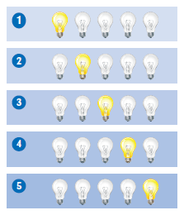
Problem Solving: Estimating the Running Time of an Algorithm – Linear Time
Pattern of array element visits
There are a fixed number of actions in each visit independent of n.
A loop with n iterations has O(n) running time if each step consists of a fixed number of actions.

Slide 93
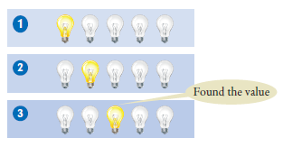
Problem Solving: Estimating the Running Time of an Algorithm – Linear Time
Example: an algorithm to determine if a value occurs in the array
boolean found = false;
for (int i = 0; !found && i < a.length; i++)
{
if (a[i] == value) { found = true; }
}
Search may stop in the middle
Still O(n) because we may have to traverse the whole array.

Slide 94


Problem Solving: Estimating the Running Time of an Algorithm – Quadratic Time
Problem: Find the most frequent element in an array.
Try it with this array
Count how often each element occurs.
Put the counts in an array
Find the maximum count
It is 3 and the corresponding value in original array is 7

Slide 95
Problem Solving: Estimating the Running Time of an Algorithm – Quadratic Time
Three phases in the algorithm
Compute all counts. O(n²)
Compute the maximum. O(n)
Find the maximum in the counts. O(n)
A loop with n iterations has O(n²) running time if each step takes O(n) time. The big-Oh running time for doing several steps in a row is the largest of the big-Oh times for each step.

Slide 96
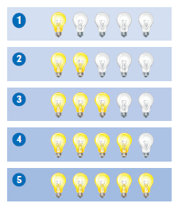
The Triangle Pattern
Try to speed up the algorithm for finding the most frequent element.
Idea - Before counting an element, check that it didn't already occur in the array
At each step, the work is O(i)
In the third iteration, visit a[0] and a[1] again

Slide 97
The Triangle Pattern
n²/2 lightbulbs are visited (light up)
That is still O(n²)
A loop with n iterations has O(n²) running time if the i^{th} step takes O( i ) time.

Slide 98


Problem Solving: Estimating the Running Time of an Algorithm – Logarithmic Time
Logarithmic time estimates arise from algorithms that cut work in half in each step.
Another idea for finding the most frequent element in an array:
Sort the array first
This is O(n log(n)) time
Traverse the array and count how many times you have seen that element:

Slide 99
Problem Solving: Estimating the Running Time of an Algorithm – Logarithmic Time
The code
int count = 0;
for (int i = 0; i < a.length; i++)
{
count++;
if (i == a.length - 1 || a[i] != a[i + 1])
{
counts[i] = count;
count = 0;
}
}

Slide 100
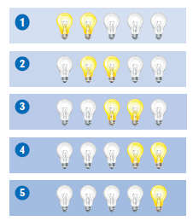
Problem Solving: Estimating the Running Time of an Algorithm – Logarithmic Time
This takes the same amount of work per iteration:
visits two elements
2n which is O(n)
Running time of entire algorithm is O(n log(n)).
An algorithm that cuts the size of work in half in each step runs in O(log(n)) time.

Slide 101
Common Recurrence Relations

Slide 102
Sorting and Searching in the Java Library - Sorting
You do not need to write sorting and searching algorithms
Use methods in the Arrays and Collections classes
The Arrays class contains static sort methods.
To sort an array of integers:
int[] a = . . . ;
Arrays.sort(a);
That sort method uses the Quicksort algorithm (see Special Topic 14.3).
To sort an ArrayList, use Collections.sort
ArrayList<String> names = . . .;
Collections.sort(names);
Uses merge sort algorithm

Slide 103
Sorting and Searching in the Java Library – Binary Search
Arrays and Collections classes contain static binarySearch methods.
If the element is not found, returns -k - 1
Where k is the position before which the element should be inserted
For example
int[] a = { 1, 4, 9 };
int v = 7;
int pos = Arrays.binarySearch(a, v);
// Returns –3; v should be inserted before position 2

Slide 104
Comparing Objects
Arrays.sort sorts objects of classes that implement Comparable interface:
public interface Comparable
{
int compareTo(Object otherObject);
}
The call a.compareTo(b) returns
A negative number if a should come before b
0 if a and b are the same
A positive number otherwise

Slide 105
Comparing Objects
Several classes in Java (e.g. String and Date) implement Comparable.
You can implement Comparable interface for your own classes.
The Country class could implement Comparable:
public class Country implements Comparable
{
public int compareTo(Object otherObject)
{
Country other = (Country) otherObject;
if (area < other.area) { return -1; }
else if (area == other.area) { return 0; }
else { return 1; }
}
}

Slide 106
Comparing Objects
You could pass an array of countries to Arrays.sort
Country[] countries = new Country[n];
// Add countries
Arrays.sort(countries); // Sorts by increasing area

